Slide 1


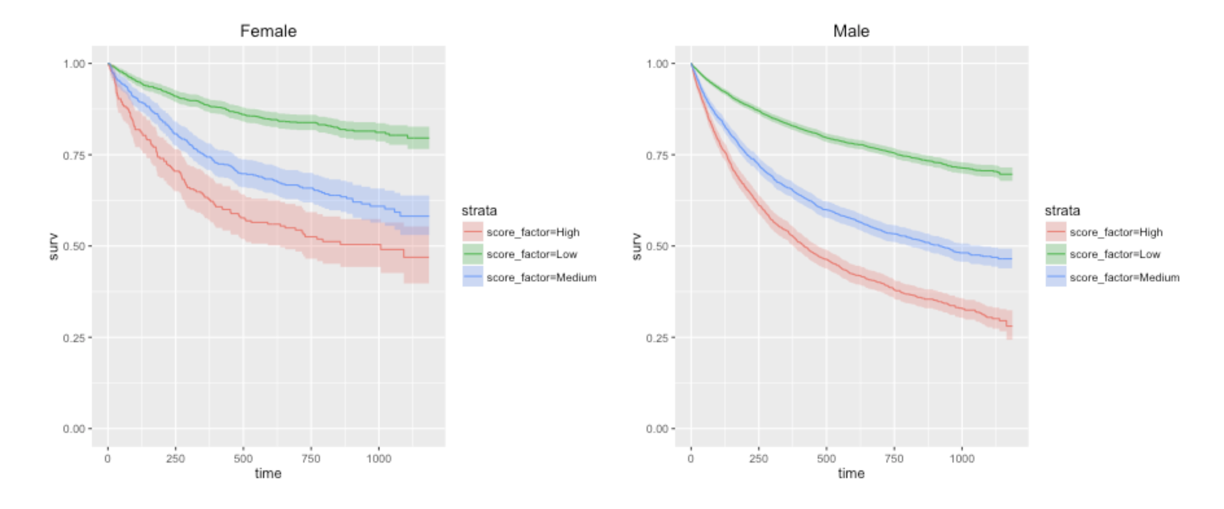
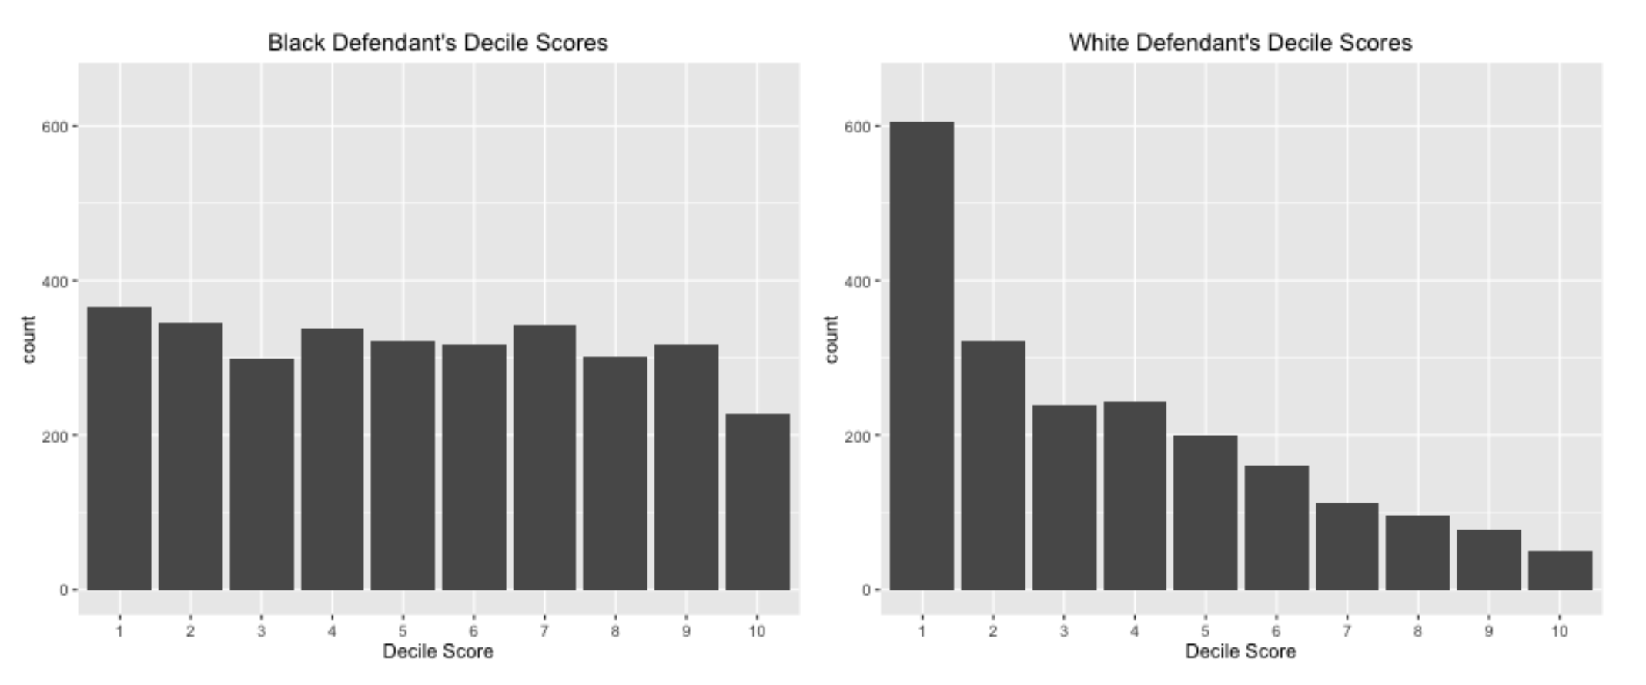
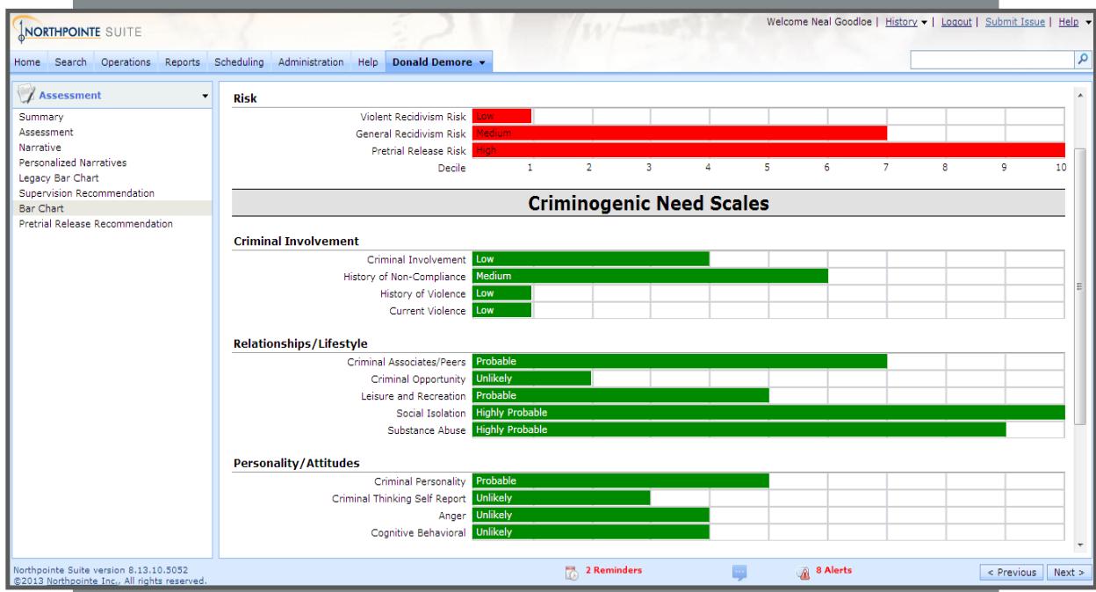
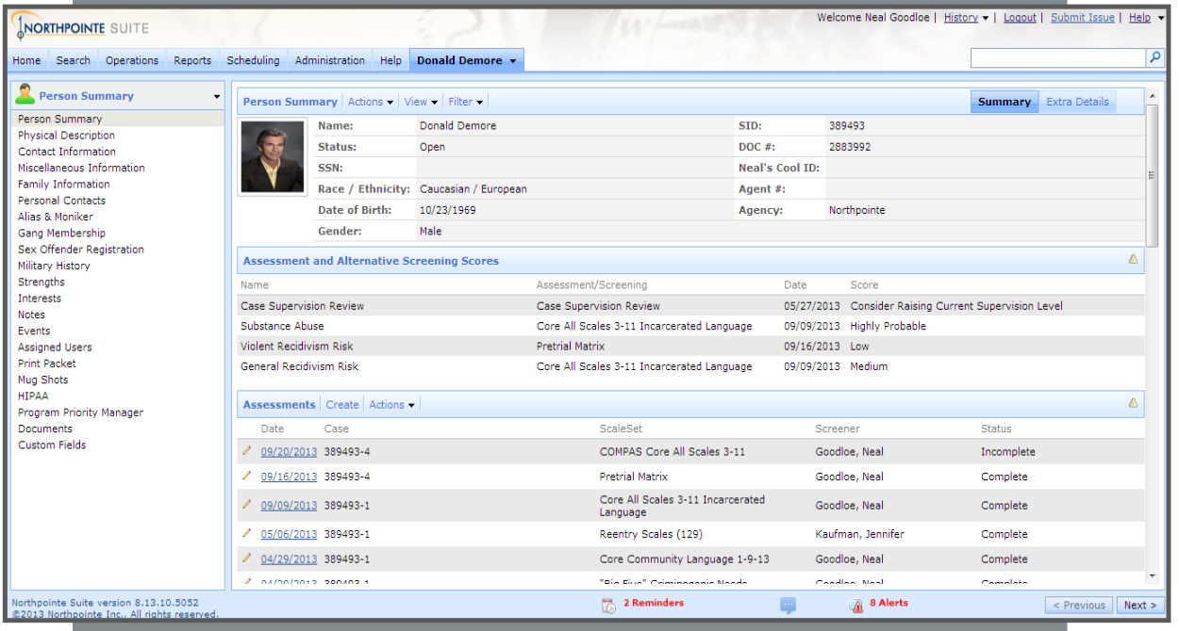
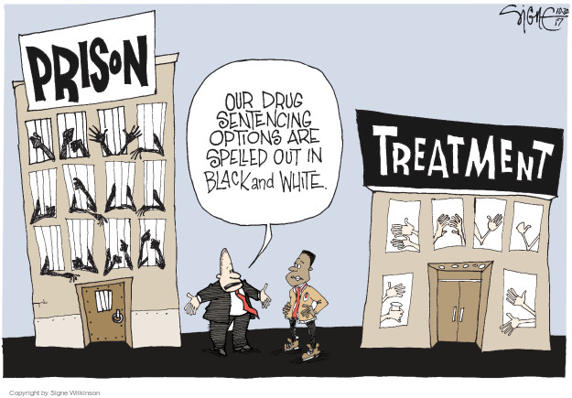
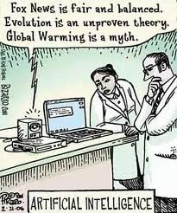

How to Incorporate Judicial Sentencing Software Into U.S. Courts
Manogna Vemulapati <mvemulap@andrew.cmu.edu>, Vidhart Bhatia <vnbhatia@andrew.cmu.edu>
Introduction
Major Positions
Topic: The use of computational algorithms for judicial sentencing in the United States.
Can the implicit biases in such algorithms be resolved?
Is there potential for a hybrid of machine and human decision-making?
What legislation should be in place regarding machine-generated sentences? Should it be standardized or regulated at a federal or state level?
The use of artificial intelligence for judicial sentencing is the best way to remove human bias
The existing software for judicial sentencing are implicitly biased, and therefore inadequate to reform the criminal justice system
No computational method for judicial sentencing can replicate the emotional components of a judge's decision making process
Background
Figure 2: Female vs. Male Violence Risk Scores
Our Position
Judges have always used risk assessment data in their decisions [3]
Selective incapacitation theory:
criminals should be held in prison longer than deserved for their crime, based on their predicted recidivism risk [3].
In direct conflict with the theory of assigning "punishment that fits the crime“.
Precedent for transparency of judicial decision making:
In 1977, Supreme Court ruled that a Florida man could not be condemned to die based on a report that contained passages he was not allowed to see.
This principle has only been applied in capital cases [2]
Existing implicit bias in U.S. court system:
In past 20 years, many ethical debates over how to reform criminal justice system to decrease bias induced by race, sex, and economic background
Make use of software in the judicial system to mitigate bias, but specify certain conditions to counteract implicit bias that may manifest in the algorithm:
Require transparency of algorithms:
Allows for defendants to argue against the decision making process.
Algorithms can be screened by a government committee.
Allows us to identify any bias that arises due to the design of the algorithm and to verify its accuracy [10].
Establish a hybrid process of both human judgement and software evaluation:
Discrepancy between human and machine predication could expose implicit bias in either party.
Software can help counteract both directions of prejudice (judicial sentences that are too lenient towards some groups, and sentences that are too harsh towards others)
Figure 3: Black vs. White Defendant's Decile Scores
Pros
Alleviates burden on the American prison system
Decreased pretrial jail population and decreased the required supervision of parolees, without adversely affecting public safety
Helps solve oversaturation problem.
Allows for resources to be diverted to better uses, such as rehabilitation programs
Artificial intelligence based decisions can help make judges more fair by forcing them to re-evaluate their own biases [8]
Case Study: COMPAS
Ethical Analysis
COMPAS, developed by Northpointe, a proprietary computational algorithm currently used in some courts
Core Risk Scales: New violent crime, General Recidivism, Pretrial Risk
Core Criminogenic Need Scales: Anger, Cognitive Behavioral, Criminal Associates & Peers, Criminal Opportunity, Criminal Personality, Family Criminality, Financial
Utilitarian philosophy:
Advocates for use of software because of the overall lower burden on our prison system (by removing lower risk defendants) and overall increase in public safety (by retaining higher risk defendants).
Desert philosophy:
Advocates against use of software because it does not proportionately assign punishment to the crime, and claims it is unfair to “punish for choices expected which have not yet been made” [3]
Cons
COMPAS is potentially implicitly biased by race and gender
ProPublica study concluded that COMPAS was far more likely to output a higher risk of violence and recidivism for black defendants [1].
The same study concluded that female defendants received lower decile scores for equivalent crimes [1]
The opacity of proprietary software prevents lawyers from being able to defend against it
Argued by the defense attorney in the Wisconsin vs Loomis case, but was unable to overturn the verdict because the COMPAS algorithm remains a blackbox [7]
Figure 1: Interface of COMPAS software
References
Angwin, J., Larson, J., Kirchner, L., & Mattu, S. (2019, March 09). Machine Bias. Retrieved from https://www.propublica.org/article/machine-bias-risk-assessments-in-criminal-sentencing
Liptak, A. (2017, May 01). Sent to Prison by a Software Program's Secret Algorithms. Retrieved from https://www.nytimes.com/2017/05/01/us/politics/sent-to-prison-by-a-software-programs-secret-algorithms.html
Kehl, Danielle, Priscilla Guo, and Samuel Kessler. 2017. Algorithms in the Criminal Justice System: Assessing the Use of Risk Assessments in Sentencing. Responsive Communities Initiative, Berkman Klein Center for Internet & Society, Harvard Law School.
Israni, E. T. (2017, October 26). When an Algorithm Helps Send You to Prison. Retrieved from https://www.nytimes.com/2017/10/26/opinion/algorithm-compas-sentencing-bias.html
Devlin, H. (2018, January 17). Software 'no more accurate than untrained humans' at judging reoffending risk. Retrieved from https://www.theguardian.com/us-news/2018/jan/17/software-no-more-accurate-than-untrained-humans-at-judging-reoffending-risk
Corbett-Davies, S., Pierson, E., Feller, A., & Goel, S. (2016, October 17). A computer program used for bail and sentencing decisions was labeled biased against blacks. It's actually not that clear. Retrieved from https://www.washingtonpost.com/news/monkey-cage/wp/2016/10/17/can-an-algorithm-be-racist-our-analysis-is-more-cautious than-propublicas/?utm_term=.140db7a96627
Tashea, J. (2018, February 02). Courts Are Using AI to Sentence Criminals. That Must Stop Now. Retrieved from https://www.wired.com/2017/04/courts-using-ai-sentence-criminals-must-stop-now/
Chen, Daniel L., Machine Learning and the Rule of Law (January 6, 2019). Computational Analysis of Law, Santa Fe Institute Press, ed. M. Livermore and D. Rockmore, Forthcoming. Available at SSRN: https://ssrn.com/abstract=3302507
Miller, A. P. (2018, July 26). Want Less-Biased Decisions? Use Algorithms. Retrieved from https://hbr.org/2018/07/want-less-biased-decisions-use-algorithms
Carlson, A. M. (n.d.). The Need for Transparency in the Age of Predictive Sentencing Algorithms. Retrieved from https://ilr.law.uiowa.edu/print/volume-103-issue-1/the-need-for-transparency-in-the-age-of-predictive-sentencing-algorithms/
Corbett-davies, S., Goel, S., & GonzÁlez-bailÓn, S. (2017, December 20). Even Imperfect Algorithms Can Improve the Criminal Justice System. Retrieved from https://www.nytimes.com/2017/12/20/upshot/algorithms-bail-criminal-justice-system.html?fbclid=IwAR2Vousp1Pl96qaIwivsqDGwETp1X2lTJMnx4bt6zqGSD2FEQAqvXyu0Zwk

